Slide 1
Operating System (CS5C02)
Implementation of a CPU Scheduling Algorithm

Slide 2
Submitted by
AAYUSHI MISHRA -- 4NI19CS002
AKSHANTULA NEHA – 4NI19CS015
To the course instructor
Dr. JAYASRI B S
(Professor & Dean--EAB)
DEPARTMENT OF COMPTER SCIENCE AND ENGINEERING
THE NATIONAL INSTITUTE OF ENGINEERING
Mysuru-570008
2021-2022

Slide 3
CPU SCHEDULING ALGORITHMS
A Process Scheduler schedules different processes to be assigned to the CPU based on particular scheduling algorithms. These algorithms are either non-pre-emptive or pre-emptive. Non-pre-emptive algorithms are designed so that once a process enters the running state, it cannot be pre-empted until it completes its allotted time, whereas the pre-emptive scheduling is based on priority where a scheduler may pre-empt a low priority running process anytime when a high priority process enters into a ready state.

Slide 4
SRTF – CPU SCHEDULING ALGORITHM
Shortest Remaining Time First (SRTF) is the pre-emptive version of Shortest Job Next (SJN) algorithm, where the processor is allocated to the job closest to completion.

Slide 5
Algorithm:
1- Traverse until all process gets completely executed.
a) Find process with minimum remaining time at every single time lap.
b) Reduce its time by 1.
c) Check if its remaining time becomes 0
d) Increment the counter of process completion.
e) Completion time of current process = current time +1;
f) Calculate waiting time for each completed process.
wt[i]= Completion time - arrival_time-burst_time
g)Increment time lap by one.
2- Find turnaround time,waiting time and response time.

Slide 6
Advantages and Disadvantages:
Advantages: SRTF algorithm makes the processing of the jobs faster than SJN algorithm, given it’s overhead charges are not counted.
Disadvantages: The context switch is done a lot more times in SRTF than in SJN, and consumes CPU’s valuable time for processing. This adds up to it’s processing time and diminishes it’s advantage of fast processing.

Slide 7
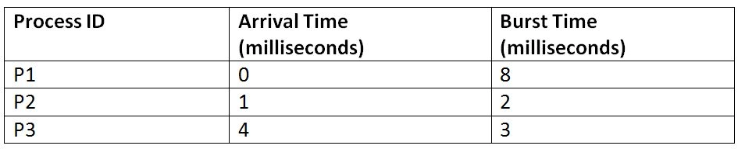
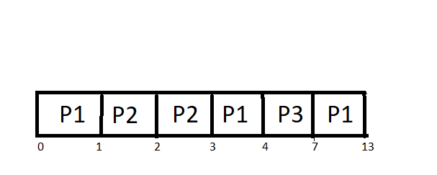
Example:
Suppose we have the following 3 processes with process ID's P1, P2, and P3 and they arrive into the CPU in the following manner:
Gant Chart:

Slide 8
Explanation:
At the 0th unit of the CPU, we have only process P1, so it gets executed for the 1-time unit. At the 1st unit of the CPU, the Process P2 also arrives. Now, the P1 needs 7 more units more to be executed, and P2 needs only 2 units. So, P2 is executed by pre-empting P1. P2 gets completed at time unit 3, and unit now no new process has arrived. So, after the completion of P2, again P1 is sent for execution. Now, P1 has been executed for one unit only, and we have an arrival of new process P3 at time unit 4. Now, the P1 needs 6-time units more and P3 needs only 3-time units. So, P3 is executed by pre-empting P1. P1 gets completed at time unit 7, and after that, we have the arrival of no other process. So again, P1 is sent for execution, and it gets completed at 13th unit. SRTF algorithm.

Slide 9
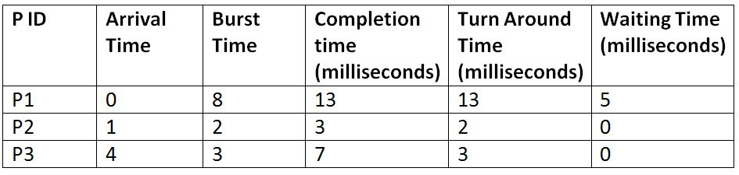
Total Turn Around Time = 13 + 2 + 3 = 18 milliseconds
Average Turn Around Time= Total Turn Around Time / Total No. of Processes = 18 / 3 = 6 milliseconds
Total Waiting Time = 5 + 0 + 0 = 5 milliseconds
Average Waiting Time = Total Waiting Time / Total No. of Processes = 5 / 3 = 1.67 milliseconds

Slide 10
THANK YOU

